Slide 1
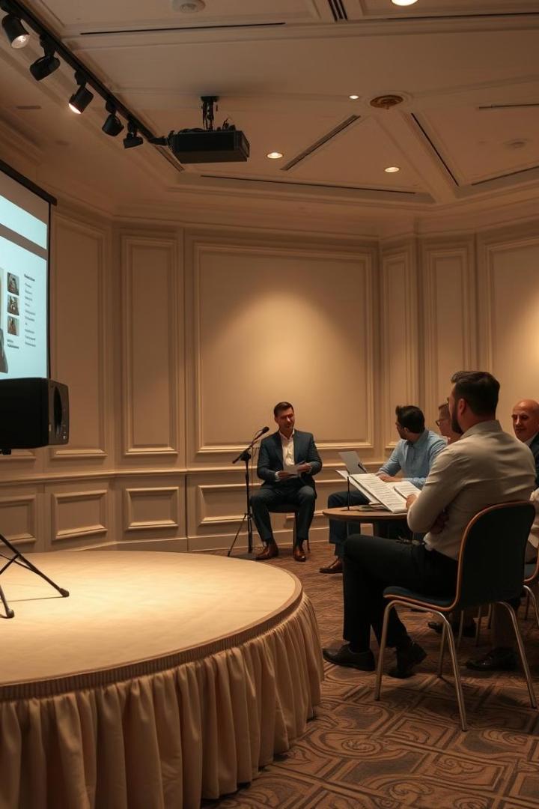
Presentation on Standards on Review Engagements (SRE 2400 & SRE 2410)
Presented By: Sanjeev Aditya M Date: 11th December 2024

Slide 2
Introduction to Review Engagements
What is Review?
Types of Review Engagements
A Review is a limited assurance engagement. Limited assurance is the level of assurance obtained where the engagement risk is reduced to a level that is acceptable in the circumstances of the engagement, but where that risk is greater than for a reasonable assurance engagement, as the basis for expressing a conclusion.
- SRE 2400: Engagements to Review Historical Financial Statements. -- SRE 2410: Review of Interim Financial Information Performed by the Independent Auditor of the Entity.

Slide 3
Audit vs Review
Audit engagement has many similarities with review engagement. However, there are certain important areas of distinction relating to the nature of engagement, its performance, objective & reporting highlighted below:
Difference between SRE 2400 and SRE 2410
Review historical financial statements (SRE 2400) vs. Review of Interim Financial Information.
Review under SRE 2400 not required to be conducted by the statutory auditor unlike SRE 2410.
Reasonable Assurance vs Limited Assurance
Audit Procedures (Test of Controls and Substantive) vs. Review Procedures (Inquiry and Analytical Procedures)
Audit arrives at an opinion vs. Review arrives at a conclusion
Positive wording in reporting vs. Negative wordings in reporting

Slide 4
SRE 2400: Engagements to Review Historical Financial Statements.
Scope and Applicability • SRE 2400 applies to practitioners who are not the statutory auditors of the entity. • It is relevant for entities requiring assurance on historical financial statements, typically for specific users or purposes, without the cost or rigor of a full audit.
Objectives of the Practitioner The practitioner’s objectives under SRE 2400 are: 1. Obtain Limited Assurance: o To determine, through inquiry and analytical procedures, whether the financial statements are free from material misstatements. 2. Report on Financial Statements: o To issue a conclusion stating that nothing has come to their attention to suggest material misstatements in the financial statements.

Slide 5
Compliance with Ethical Requirements & Engagement Level Quality Control
The practitioner shall comply with relevant ethical requirements, including those pertaining to independence & the engagement partner is responsible for overall quality of each review engagement.
Client Acceptance & Continuance:
Unless required by law or regulation, the practitioner shall not accept a review engagement if: (i) That there is no rational purpose for the engagement. (when any law requires an audit but the appointment is for a review) (ii) That a review engagement would not be appropriate in the circumstances. (iii) The practitioner has reason to believe that relevant ethical requirements, including independence, will not be satisfied. (iv) If there is a possibility of limitation of scope.
Both Ethical Requirements and the Standard on Quality Control (SQC – 1) will be applicable to a review.

Slide 6
Overview of Performing the Review Engagement After Its Acceptance
1
2
3
Obtaining an Understanding of the Entity:
Materiality in a Review of Financial Statements:
Designing and Performing Review Procedures:
• The practitioner shall obtain an understanding of the entity and its environment and the applicable financial reporting framework to identify areas in the financial statements where material misstatements are likely to arise.
• The practitioner shall determine materiality for the financial statements as a whole. • No separate materiality is set for particular class of transactions, account balances or disclosures as detailed audit procedures is not conducted.
The practitioner shall design and perform inquiry and analytical procedures: To address all material items in the financial statements, including disclosures and To focus on addressing areas in the financial statements where material misstatements are likely to arise.

Slide 7
Overview of Performing the Review Engagement After Its Acceptance
Procedures to Address Specific Circumstances in a Review Engagement
Additional Procedures when the practitioner becomes aware that the FS may materially misstated:
During the review engagement, the practitioner shall also comply with the Standards on Auditing by performing specific procedures to address certain circumstances. These circumstances include: • SA – 550: Related Parties • SA – 240: Fraud and Non-Compliance with Laws or Regulations • SA – 570: Going Concern • SA – 620: Use of Work Performed by Others • SA – 560: Subsequent events • SA – 580: Written representations
- Practitioner to perform additional procedures when he/she becomes aware that the financial statements may be materially misstated. - They may include further inquiry, more detailed analytical procedures, or other procedures like substantive tests or external confirmations. The practitioner must continue these procedures until a conclusion can be reached: - The matter is unlikely to cause a material misstatement - The matter does cause a material misstatement - It is not possible to form a conclusion, leading to a scope limitation Based on this conclusion, the practitioner may need to modify the conclusion on the financial statements.

Slide 8
SRE 2410 - Review of Interim Financial Information Performed by the Independent Auditor of the Entity
Obtain and Update the understanding of the entity and its internal controls:
1
- Reading recent annual and prior period financial information. - Effect of corrected and uncorrected misstatements in the previous year financial statements - Obtaining and reading the internal audit reports and the replies given by the management for the points raised.
2
Considering Materiality in a Review of Interim Financial Information
Inquiries, Analytical and Other Review Procedures
- Read the minutes of the meetings of shareholders, those charged with governance, and other appropriate committees to identify matters that affect the interim financial information - Inquiry with the members of the management responsible for financial and accounting matters, and others as appropriate. a) Inquire regarding changes in accounting policies b) Unusual or complex transactions or events c) Related Party Transactions and their accounting d) Significant changes in contingent liabilities and commitments - Agree / reconcile the Interim financial information to the underlying accounting records
3

Slide 9
Other Aspects to be Covered in a Review
1
Procedures to Address Specific Circumstances in a Review Engagement – Similar to SRE 2400 such as inquiring about Going Concern, Subsequent Events, Related Party Transactions etc.
2
Obtain Written Representations from the management for acknowledgement of its responsibilities
3
Significant matters or material adjustments to be made shall be communicated to Those Charged with Governance and effect of the same should be considered while drafting the report.
4
Contents of Report
- Title - Addressee - Introductory Paragraph – identifying the financial statements/information reviewed as the case may be - Responsibility of Management – preparation of and the internal control relating to financial statements/information. - Practitioner’s/Auditor’s Responsibilities – to provide only a conclusion - Description of a review and its limitations – (limited assurance, reduced scope of work performed and only conclusion is given) - Conclusion Paragraph including modified conclusions (Adverse, Disclaimer, Qualified) if any. - The Date of the Report - Signature - The Place of Signature

Slide 10
Thank You

